Slide 1
Chapter 4
Information System and Systems Analysis and Design

Slide 2
Learning Objectives
Explain the parts of an information system: people, procedures, software, hardware, data, and the Internet
Explain the functional view of an organization and describe each function
Describe the management levels and the informational needs for each level in an organization
Discuss how information flows within an organization

Slide 3
Learning Objectives
Discuss computer-based information systems.
Distinguish among a transaction processing system, a management information system, a decision support system, and an executive support system.
Distinguish between office automation systems and knowledge work systems.
Explain the difference between data workers and knowledge workers.

Slide 4
Part 1: Information System

Slide 5

Introduction
An information system is a collection of people, procedures, software, hardware, data, and the Internet
They all work together to provide information essential to running an organization
Computers are used in organizations to keep records of events
Competent end users need to understand how the information flows as it moves through an organization

Slide 6
People
It is easy to overlook people as one of the parts of an information system
Yet this is what personal computers are all about—making people, and the end users like you, more productive
People are involved in information systems in just about every way
People as a creator of information systems
people who develop the information systems
people as a support for information systems
people who use information systems

Slide 7
Procedures
The rules or guidelines for people to follow when using software, hardware, and data are procedures.
These procedures are typically documented in manuals written by computer specialists.
Software and hardware manufacturers provide manuals with their products. These manuals are provided in either printed or electronic form.

Slide 8
Software
A program consists of step-by-step instructions that tell the computer how to do its work.
The purpose of the software is to convert data (unprocessed facts) into information (processed facts).
For example, a payroll program would instruct the computer to take the number of hours you worked in a week (data) and multiply it by your pay rate (data) to determine how much you are paid for the week (information).

Slide 9
Hardware
The equipment that processes the data to create information is called hardware.
It includes smartphones, tablets, keyboards, mice, displays, system units, and other devices.
Hardware is controlled by software.

Slide 10
Data
The raw, unprocessed facts, including text, numbers, images, and sounds, are called data.
Processed data yields information, and this Data must
Accurate
Timely
Specific
Organized for a purpose,

Slide 11
Internet
Almost all information systems provide a way to connect to other people and computers, typically using the Internet.
This connectivity greatly expands the capability and usefulness of information systems.

Slide 12
Why are computers used in organizations?
To keep records of events.
To help make decisions.
For example:
Point-of-sale terminals record sales as well as which salesperson made each sale. This information can be used for decision-making. For instance, it can help the sales manager decides which salespeople will get year-end bonuses for doing exceptional work.

Slide 13


Do not just keep track of transactions and day-to-day business operations.
Information flows vertically and horizontally throughout an organization
Information systems support the natural flow of information within an organization’s structure
5 Functional Areas
Management Levels
Information Flow
Notes:
Organizations can be viewed according to how they function: (Diagram with five functions shown on next slide)
Management has three levels : top, middle and supervisors
Information flows up, down, and across
A good exercise is to use an order entry company as an example. Have the students trace how a transaction starts with a telephone or computer order for goods.

Slide 14

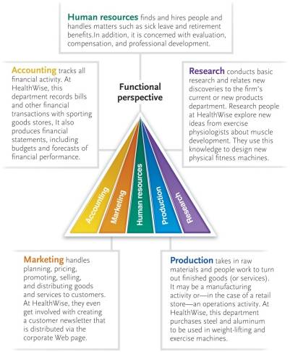
Accounting
Marketing
Human Resources
Production
Research
Notes:
Accounting – records all financial activity from billing customers to paying employees
Marketing – plans, prices, promotes, sells, and distributes the organization’s goods and services
Human resources – focuses on people—hiring, training, promoting, and other human-centered activities
Production – actually creates finished goods and services using raw materials and personnel
Research – identifies, investigates, and develops new products and services

Slide 15

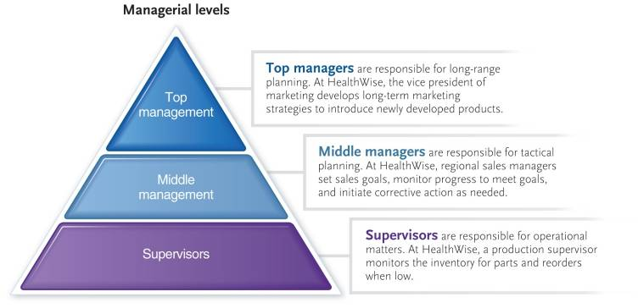
Management is usually divided into three levels: Top, Middle, and Supervisors
Notes:
Supervisors (Key Term): Responsible for operational matters; control matters; detailed, day-to-day information
Middle managers: Responsible for tactical planning or control planning and decision making; need summarized weekly or monthly information; responsible for long term goal implementation
Top managers: Involved with long-range planning; responsible for strategic planning; need highly summarized information; also need information from outside sources

Slide 16


Each level of management has different information needs
The information flows to support these needs
Top management
Vertical, horizontal, and external
Middle management
Vertical and horizontal
Supervisor
Primarily vertical
Notes:
Most organizations have three levels of management; may see some overlap between supervisor and middle management
Top management almost always requires information from the “below” and from all departments; therefore, information is vertical; they also need information outside the organization from external sources
Middle Management – the information flow is both vertical and horizontal across functional lines
Supervisors – supervisors communicate mainly with their middle management and the workers they supervise underneath their level of management

Slide 17

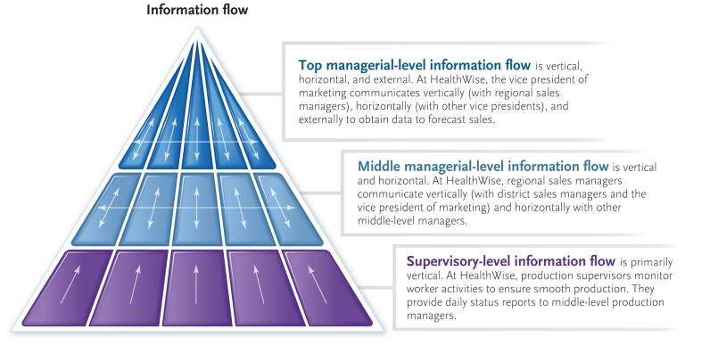
Notes:
An example of an information flow pattern within an organization

Slide 18

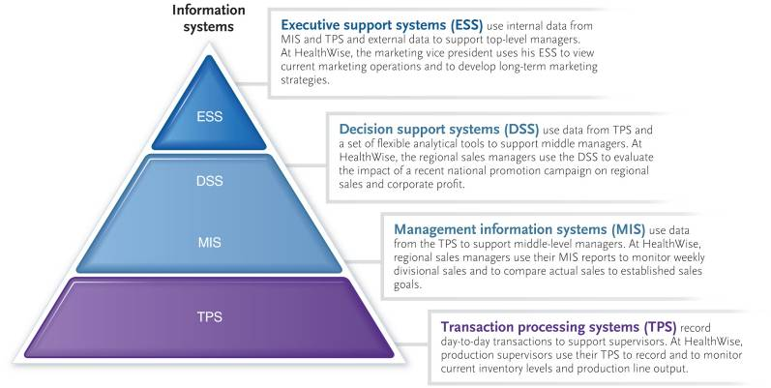
Notes:
Almost all organizations have computer-based information systems
Four types of computer-based information systems that help track and keep information flowing in the amount and direction organization needs to stay on track:
TPS –Transaction processing system; records day-to-day transactions; foundation for other information systems
MIS – Management information system; summary of detail from TPS; produces standard reports for management
DSS – Decision support system; data source: flexible analytical tool; assists managers with solutions for a wide range of problems; uses the TPS
ESS – Executive support system is also referred to as the Executive information system (EIS) (Key Term) ; highly summarized information presentations; gives senior management a broad company view, assists with strategic planning; sourced internally from TPS and MIS, and from external sources

Slide 19

Question to be answered
What is a transaction processing system? How does it help supervisors?
What is a management information system (MIS)?
What is a decision support system (DSS)?
How are MIS is different from DSS?
What is an executive support system? Who uses it? What is it used for?

Slide 20

Records day-to-day transactions in a database
Also called data processing systems (DPS)
Transaction processing systems generally go through a five-stage cycle of
Data entry activities
Transaction processing activities
File and database processing
Document and report generation
Inquiry processing activities.
Notes:
Records routine, day-to-day operations in a database
Foundation for other information systems within organization
Associated with sales, order processing, inventory (Key Term), purchasing (Key Term), accounts payable (Key Term), accounts receivable (Key Term), payroll (Key Term) – other accounting functions.

Slide 21
Examples of TPS systems
Sales order entry
Hotel reservation systems
Payroll
Employee record keeping
Automated teller machines
Credit card authorizations
Online bill payments
Self-checkout stations at grocery store
The trading of stocks over the Internet
Many other electronic commerce

Slide 22
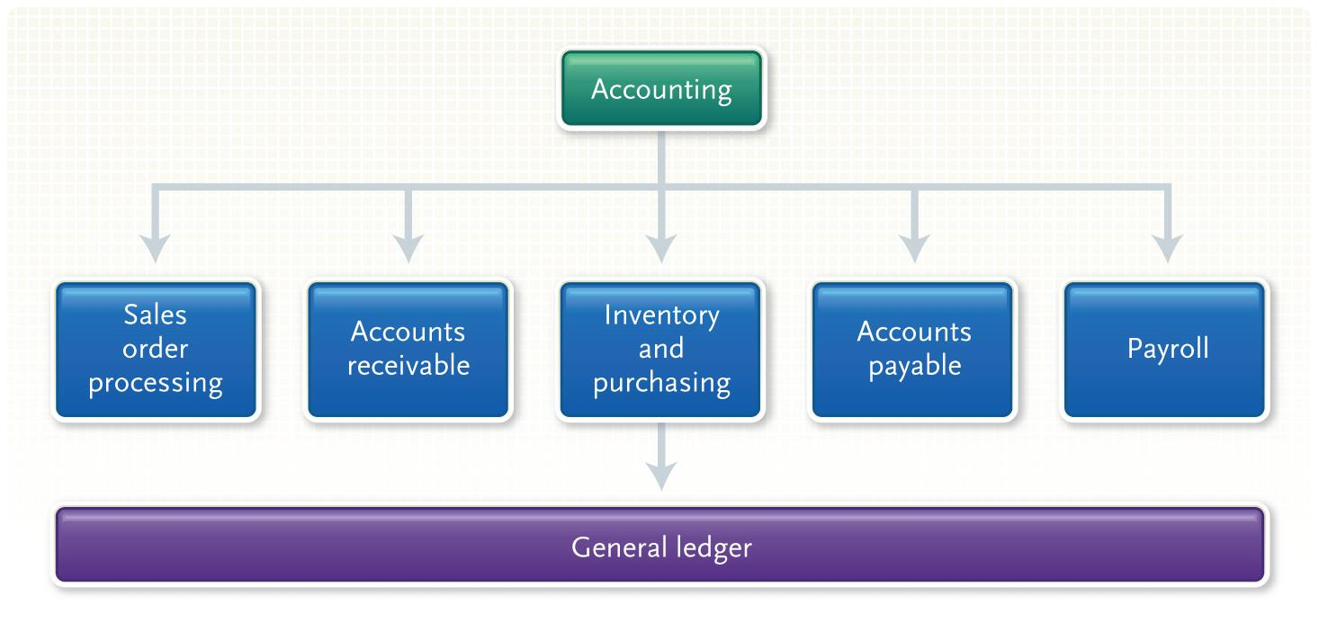
Example works of TPS for Accounting
Sales order processing
Accounts receivable
Inventory and purchasing
Notes:
A transaction processing system helps an organization to keep track of routine operations
Records information in a database to provide users access to the information via queries and/or reports
The accounting area is one of the most essential areas in an organization with six major activities:
Sales order processing – records customer requests—this usually starts the flow of information
Accounts receivables – records money received from or owed by customers
Inventory – parts and finished goods that the company has in stock
Inventory control system (Key Term) – Keeps record of each kind of part or finished good in the warehouse
Purchasing is the buying of materials and services
Purchase order (Key Term) is a form used
Accounts payables refers to money the company owes its suppliers for materials and services it has received
Payroll – concerned with calculating employee paychecks
General ledger – keeps track of all summaries of all the foregoing transactions and produces…
Income Statements (Key Term) – show a company’s financial performance
Balance sheets (Key Term) – list the overall financial condition of an organization
Other TPS that you might use: ATMs and online student registration systems

Slide 23

What is MIS?
MIS is the use of information technology, people, and business processes to record, store and process data to produce information that decision-makers can use to make day-to-day decisions.
Notes:
MIS use databases; DBMS required to integrate the databases of the different departments
A computer-based information system that produces standardized reports in summarized, structured form
Periodic – produced at regular intervals
Exception – call attention to unusual events
Demand – opposite of periodic, is produced only upon request

Slide 24
The need for MIS
MIS provides the information needed for decision-makers to make effective decisions.
MIS systems provide a smooth way of communication within and outside the organization
Record keeping – MIS records all an organization's business transactions and provides a reference point.

Slide 25
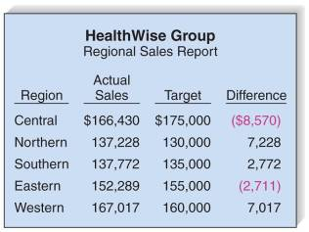
Produces standardized reports to support decision-making by middle managers
Integrates data and summarizes details from databases in a structured form
Produces predetermined reports
Periodic reports
Exception reports
Demand reports
Notes:
MIS use databases; DBMS required to integrate the databases of the different departments
A computer-based information system that produces standardized reports in summarized, structured form
Periodic – produced at regular intervals
Exception – call attention to unusual events
Demand – opposite of periodic, is produced only upon request

Slide 26
Examples of MIS
Some other examples of management information systems in an organisation
process control,
office automation
enterprise resource planning
finance systems
management reporting
and many more …

Slide 27

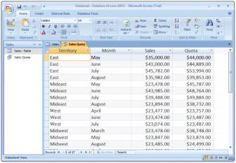
Flexible tool for analyzing data for decision-making purposes
Enables managers to get answers to unexpected and generally non-recurring problems
Reports do not have a fixed format
Microsoft Access is often used to provide an easy front-end interface for performing SQL decision support queries
Notes:
DSS is quite different from transaction processing system
Gives a summary of the data
Helps decision makers analyze unanticipated situations
Managers often must contend with unanticipated questions; DSS help provide answers to unexpected, non-recurring problems
DSS helps user (management or otherwise) make decisions
For larger problems a group decision support system (GDSS) (Key Term) is used

Slide 28


User
A decision-maker, like yourself
System software
Operating system
Easy to learn and use
Data
Internal data
External data
Decision models
Notes:
DSS consists of four parts
User – someone who has to make decisions
System software – essentially the operating system
Data – stored in a DSS and consists of two kinds:
Internal data – data from within the organization
External data – data gathered from outside the organization; Example: marketing research firms; trade associations; U.S. government
Decision model (Key Term) – three types are displayed on next slide

Slide 29

Strategic models
Assists top level management in long-range planning
Tactical models
Assists middle-management control the work
Financial and sales promotion planning
Operational models
Assists lower-level managers accomplish the daily activities and objectives

Slide 30
Examples of DSS
GPS: A GPS analyzes route information and traffic data to plan the best path between places.
Crop planning: Decision support systems help farmers know the best time to plant, fertilize and harvest crops.
Enterprise resource planning (ERP) dashboards: Decision-makers use ERP dashboards to oversee performance indicators.
Clinical decision-making: Medical professionals use clinical decision-support systems to help diagnose and plan treatment for patients.

Slide 31

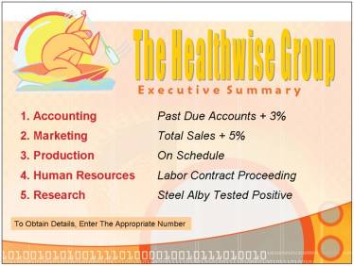
Designed for top management
Sophisticated software for presenting, summarizing, and analyzing data, but specifically designed to be easy-to-use
Provides immediate access to a company's key performance indicators
Notes:
ESS is a like a DSS or MIS that can present, summarize, and analyze data from an organization’s databases
Emphasis on ease of use so that executives may operate without extensive training
Easy, direct access about the company’s performance; highly summarized information to help make decisions; combines internal data from TPS and MIS with external data

Slide 32


Information workers
Data workers
Knowledge workers
Office automation systems (OASs)
Supports data workers
Project management programs
Videoconferencing systems
Knowledge work systems (KWSs)
Use specialized systems, such as
CAD/CAM
Notes:
Information workers create, distribute, and communicate information.
Information workers –
Communication and distribution - data workers; include but not limited to secretaries, clerks,
Creation - knowledge workers; engineers, and scientists
Office automation systems (OASs) support the activities of data workers by managing documents, communications, and scheduling. Secretaries and clerks are data workers
Project Managers – programs designed to schedule, plan, and control project resources
Videoconferencing systems – computer systems using the computer and Internet that allow people located at various geographical locations to communicate and conduct in-person meetings
Knowledge work systems (KWSs)
CAD/CAM (computer-aided design/computer-aided manufacturing) (Key Term) – used by design and manufacturing engineers

Slide 33
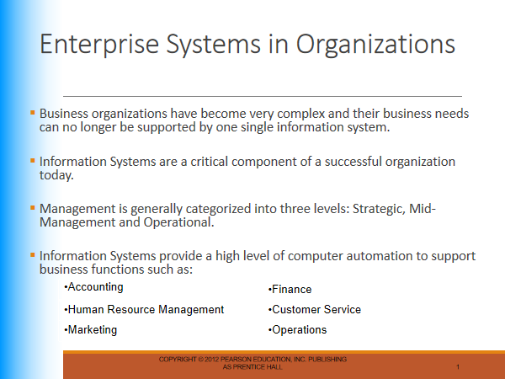

Slide 34


Information systems managers oversee the work of programmers, computer specialist, systems analysts, and other computer professionals
Employers look for individuals with strong technical backgrounds, with a Master’s degree
Strong leadership and communications skills
Information systems managers can expect to earn from RM 49,200 to RM 73,600 annually
Notes:
Information systems managers create and implement corporate computer policy and systems
Consult with management, staff, and customers to achieve goals
Advancement opportunities typically included leadership in the field
To learn about other careers in information systems, visit www.computing2011.com and enter the keyword careers

Slide 35


Information overload
May have a negative effect
E-mail is one of the major sources of overload
How to handle e-mail
Be selective
Remove
Protect
Be brief
Stop spam
Don't respond
Notes:
Question the value of technology? Has it helped or just caused more stress?
E-mail and cell phones allow communication in nearly any location. Also can be main source of too much information.
Be selective -- With e-mails, look first at the subject line in an e-mail; read only those of direct and immediate interest
Remove – After reading an e-mail, respond if necessary; then either file it or delete it
Protect – Limit your e-mail by giving your address to only those who need it
Be brief – When responding, be concise and direct
Stop spam –Spam is unwanted email advertisements. Avoid mailing lists, complain to those who send spam, and ask to have your name removed from their mailing list
Don’t respond – You do not have to respond to an e-mail. Be selective; respond only to those worthy of your time

Slide 36

Name and discuss the five common functions of most organizations.
Discuss the roles of the three kinds of management in a corporation.
What are the four most common computer-based information systems?
Describe the different reports and their roles in managerial decision making.
What is the difference between an office automation system and a knowledge work system?
Notes:
Have students turn to the end of Chapter 11 in their textbooks to view the same “Open-Ended” questions/statements

Slide 37
Part 2: Systems Analysis and Design

Slide 38

Learning Objectives
Describe the six phases of the systems life cycle.
Identify information needs and formulate possible solutions.
Analyze existing information systems and evaluate the feasibility of alternative systems.

Slide 39
Learning Objectives
Identify, acquire, and test new system software and hardware.
Switch from an existing information system to a new one with minimal risk.
Perform system audits and periodic evaluations.
Describe prototyping and rapid applications development.

Slide 40

Most people in an organization are involved with an information system of some kind.
For the organization to create and use the system requires thought and effort.
In this chapter, you learn about history of software development methodology, six step process for performing systems analysis and design.

Slide 41
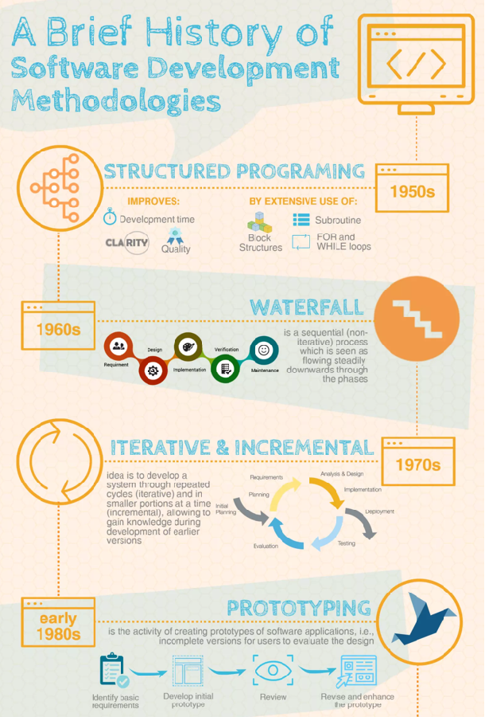

Slide 42
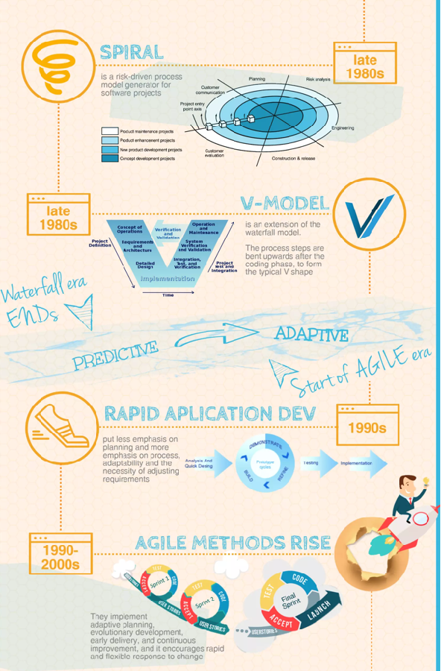

Slide 43
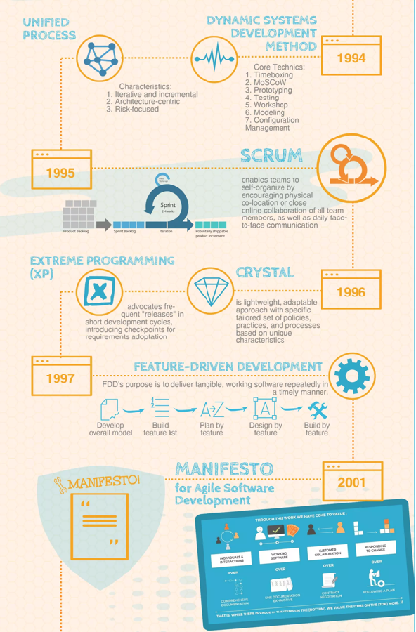

Slide 44
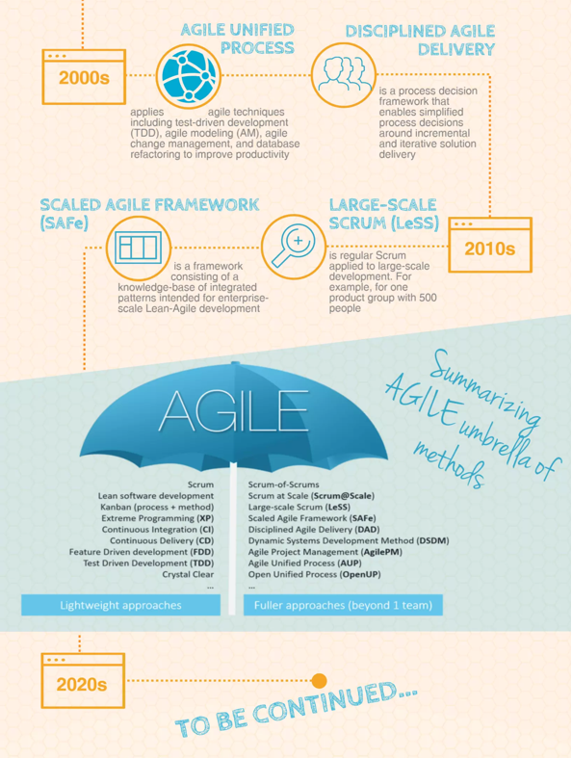

Slide 45

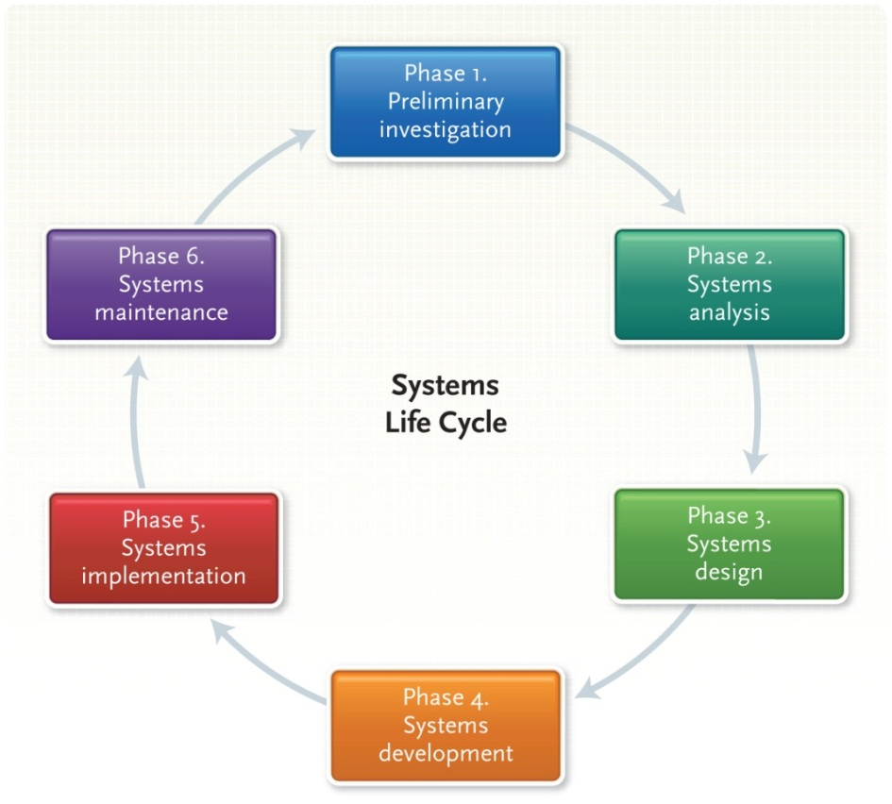
Six-phase problem-solving procedure for examining and improving an information system
Notes:
Information flows into an organization from the outside and flows inside the organization to accomplish a task or solve a problem.
Periodically the flow of the information needs to be evaluated – is it effective? Is it solving the problem or creating others? Is there a newer or better way to get the task accomplished or solve the problem? How do we go about beginning an analysis of any system? It is important that end users understand how the systems life cycle works—in fact, end users have to use the procedure if developing your own information system.
Preliminary Investigation (key term) – First phase is to perform an investigation – usually the result of a request from the user (is there a way to make this task easier, to accomplish the job more efficiently?)
Systems analysis (key term) – The second phase is to analyze the current procedure(s) to determine if there is a need for a new system or a modification of the current system
Systems Design (key term)– The third phase is to design a new model or make adjustments to the current model to fit new needs or changes in technology
Systems Development (key term)– The fourth phase is Development – This is the acquisition of new software and/or hardware and the testing of that new acquisition
Systems Implementation (key term) – The fifth phase is to determine how to implement the changes from Development – do we do this all at once; step by step; or phase it in?
Systems Maintenance (key term) – the last phase – needs to be performed as you go through the process of analyzing, as you work with the new/changed system, as you implement the new system or the new changes, and on a routine basis to be sure you are accomplishing what you set out to accomplish: making the task easier and more efficient!
*The following slides provide an overview of each of the six phases

Slide 46

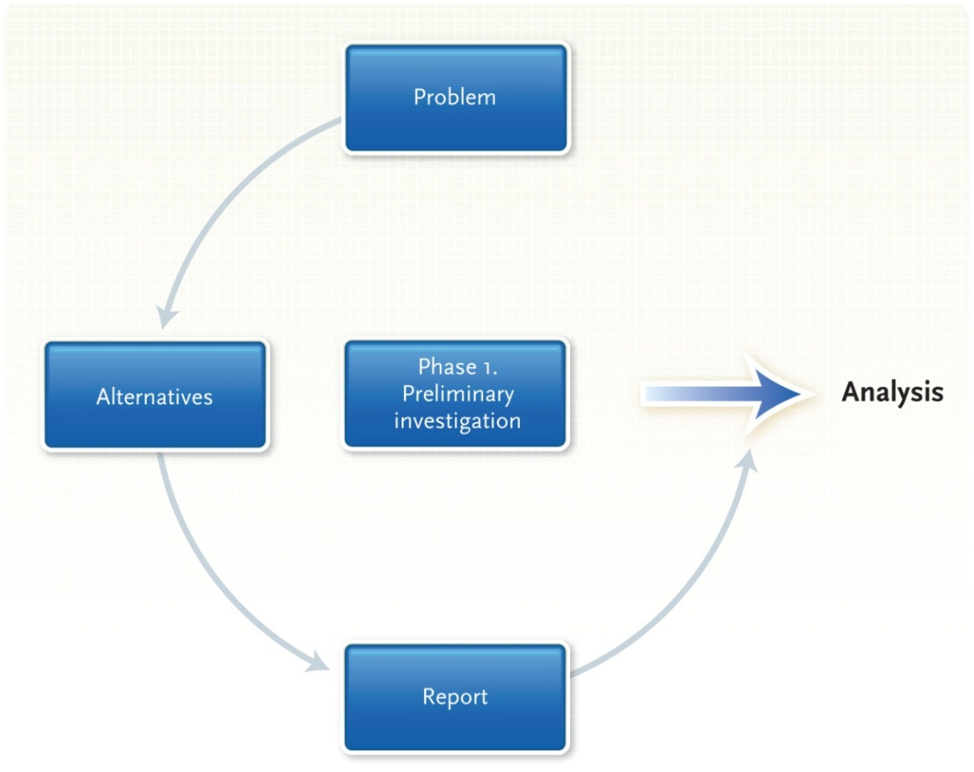
The preliminary investigation determines the need for a new information system
Notes:
During Phase I, you have received a request from a user to see if there is a more efficient or easier way to get his/her job done
There are three tasks to be completed:
The problem is “defined” by you in coordination with the user or perhaps you are the one soliciting the help from the systems analyst (key term) to make your job more efficient
Be specific in what you want changed or are looking for; examine the current system and then decide what information is needed and gathering information is accomplished by interviewing and making observations. Suggest alternatives; they may not be possible nor used, but the analyst will have a better idea of where you are headed.
The systems analyst will write up a short report to submit to higher management to see if management will finance the second phase – Systems Analysis

Slide 47

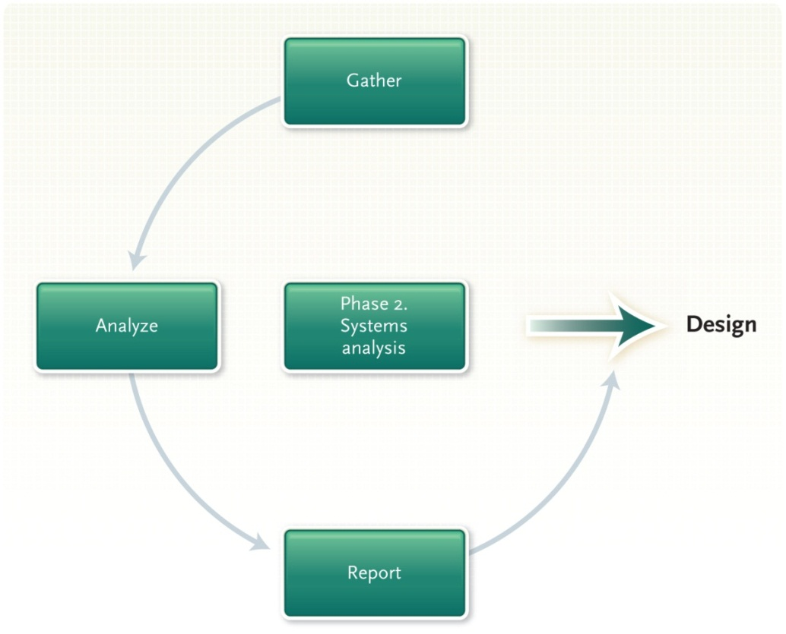
Data is collected about the present system and then analyzed to determine the new requirements
Notes:
In Phase 2, the analyst observes and interviews people involved with the system that is being reviewed.
Gathering Data - The organizational chart within the group helps determine who reports to whom and how information should be flowing through the system.
Analyzing the data - The analyst might use a grid char, or decision table, or a system flow chart. Check lists and automated tools are sometimes used in this phase. Documenting systems analysis - At the “end” of this phase, the analyst again writes a summary of his/her findings, called the systems analysis report, to give to management before proceeding to step 3 – design a new system or restructuring the current system

Slide 48

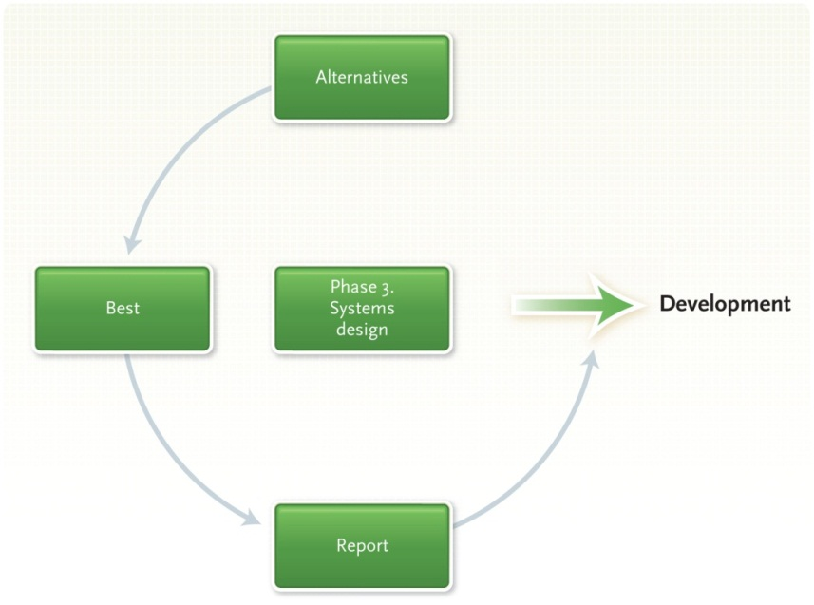
Define the alternatives, select the best system, and write a systems design report
Evaluate systems according to economic feasibility, technical feasibility, and operational feasibility
Notes:
This phase consists of looking at the feasibility of alternative systems:
Economic feasibility - Will new system be economical?
Technical feasibility - Is it technically possible?
Operational feasibility - How will the new/revised system be received by employees, managers, clients?
Selecting the best system - Will the new system fit in with current organization? After the test system is selected, will it fit within the organization; is it flexible enough to be modified; can it be made secure; and are the benefits worth the cost?
Writing the systems design report (key term)– prepared for higher management; a report is prepared that presents costs versus benefits and outlines alternatives and makes a recommendation on which way to proceed.

Slide 49

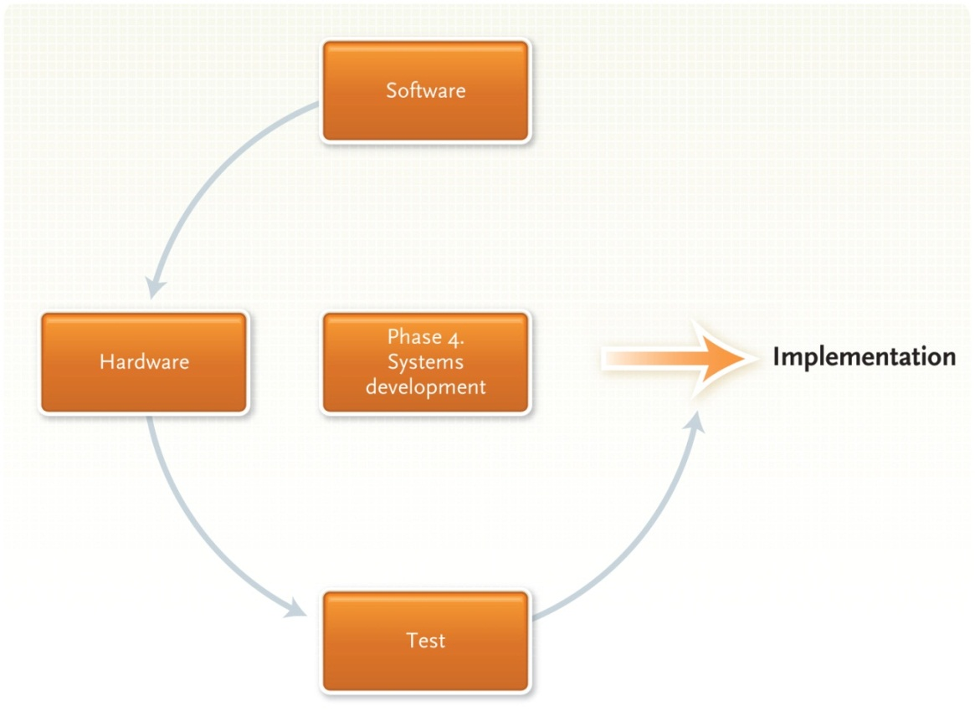
In the development phase, you acquire the software and hardware, and test the new system
Notes:
Here it is important to emphasize that the software is acquired first – whether it is off-the-shelf or custom designed, software needs to be the first consideration. The product needs to accomplish the task that has been reviewed in the previous three steps.
AFTER the software is determined, then the analyst(s) looks at the hardware – will the current hardware work or is there a need to upgrade? This can be as expensive as the software. Also important at this point is to consider if and where should new equipment go. Depending upon the activities of the user, he/she may or may not need new equipment when the system is implemented.
Finally before moving on – TEST, TEST, TEST the proposed system! Be sure that it is accomplishing the task that was originally requested and recommended in the initial systems analysis. Use Sample Data. Check to verify that the person requesting the changes is actually one of the people (groups) testing the new system!

Slide 50

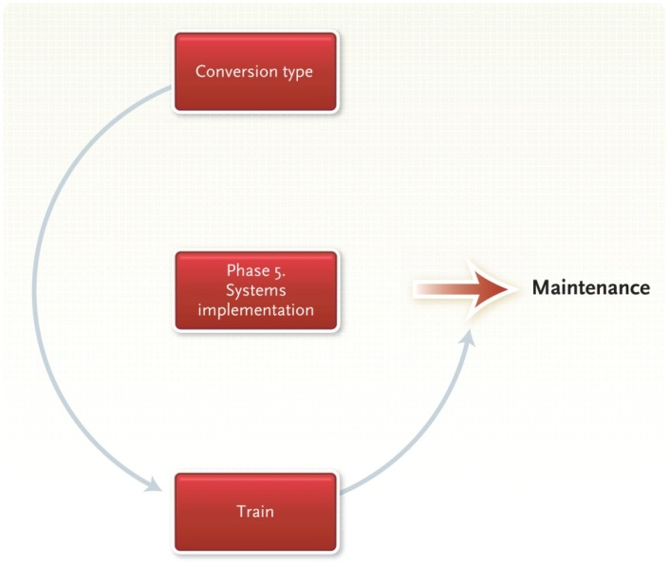
Also known as conversion
Converting from the old system to the new one
Training people to use the new system
Types of conversion approaches include:
Direct
Parallel
Pilot
Phased
Notes:
There are a variety of ways of implementing new systems: direct, parallel, pilot or phased. How the new system is incorporated will depend upon how expensive each approach is in the current organization. In some cases, throwing out the “baby with the bathwater” is the best way to implement a new system. Other times due to resistance to change, using a pilot or phased approach may work better. In all cases, cost may become the determining factor.
Four Types of conversions
Direct approach (key term) – abandon the old system and start up a new one, not recommended, too risky.
Parallel approach – old and new systems are operated side by side until new one is reliable
Pilot approach – new system is tried out in only one part of the organization first
Phased approach – new system is implemented gradually over a period of time
Generally the pilot and phased approaches are the favored methods
Remember that the more people believe to be involved, the more likely they are to accept the changes!
Training - should be considered very important. People tend to adapt to change when they are involved both in the decision-making process and knowing that they will get “help” in learning the new system.

Slide 51

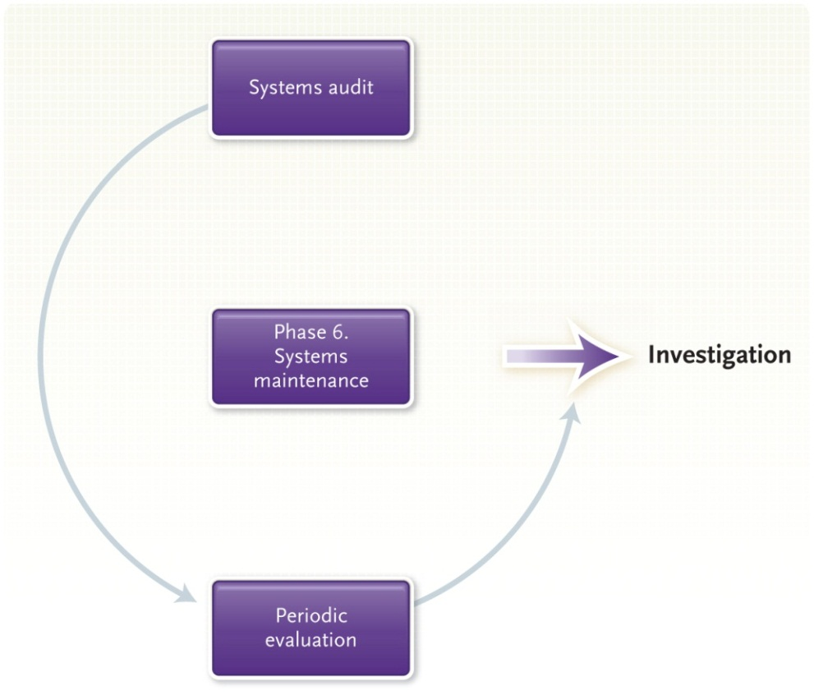
Systems maintenance is a very important, ongoing activity that includes a systems audit and a periodic evaluation
Notes:
This step has been considered the “last” step in implementing systems analysis. It is important for ALL parties to realize that maintenance is on-going, and every system needs to be evaluated on a regular basis to be sure it is meeting the needs of the people involved! This applies to the “lowest” production worker to the “highest” CEO.
All these people need to evaluate the system to be sure that all needs are being met and that technology is keeping up with the demand in the environment.
Systems audit – the system’s performance is compared to the original design specifications to determine whether the new procedures are actually furthering productivity; further modifications may be needed and made
Periodic evaluation – all systems should be evaluated from time to time to determine whether they are meeting the goals and providing the service as specified

Slide 52
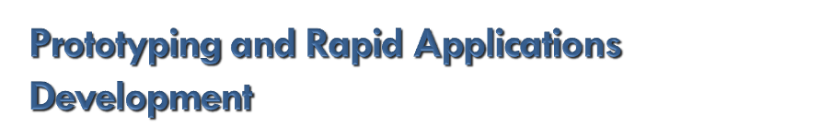
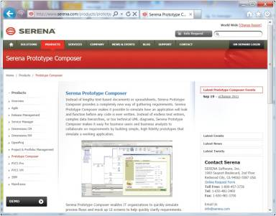
Alternatives to the systems life cycle may be used if the system is not feasible
Prototyping is building a model
Rapid applications development (RAD)
Notes:
Prototyping is building a “model” of the system you want to implement and letting people try it out and give you feedback. While development time is shorter, managing the project itself and the cost can get interesting.
RAD – Rapid Application Development – may cost more, the development time is short and the quality of the completed system is better because you use development software, specialized teams, and highly trained personnel.
In which type of situation would each be applicable? Why might you use one of these options rather than the “phase system” or one of the approaches mentioned earlier?

Slide 53


A systems analyst plans and designs new systems, following the systems life cycle
Requires a Bachelor’s degree in Computer Science or Information Systems and technical experience
Can expect to earn an annual salary of RM 48,306 to RM 72,600

Slide 54


The Challenge of Keeping Pace
To stay competitive with today’s fast business pace, new technologies must be incorporated
Increased use of RAD and prototyping
Increased use of outside consulting
Notes:
Because of the Internet and rapid advancements in technology, the 5-step analysis process is losing ground to more easily and quickly adaptable systems like prototyping and RAD
Other companies are going to outside consulting firms to help upgrade and update their systems more rapidly
What companies can you find that specialize in systems analysis and design?

Slide 55

What is a system? What are the six phases of the systems life cycle? Why do corporations undergo this process?
What are the tools used in the analysis phase? What is top-down analysis? How is it used?
What is system maintenance? When does it occur?
Explain prototyping and RAD. When might they be used by corporations?
Notes:
Have students turn to the end of Chapter 13 in their textbooks to view the same “Open-Ended” questions/statements

